Slide 1

Learning Objectives
You will learn the following:
Azure Resource Manager Templates
Save a template for a VM
Evaluate Location for New Resources
Configure a Virtual Hard Disk Template
Deploy from a Template
Create and Execute an Automation Runbook

Slide 2
Azure Resource Manager Templates

Slide 3
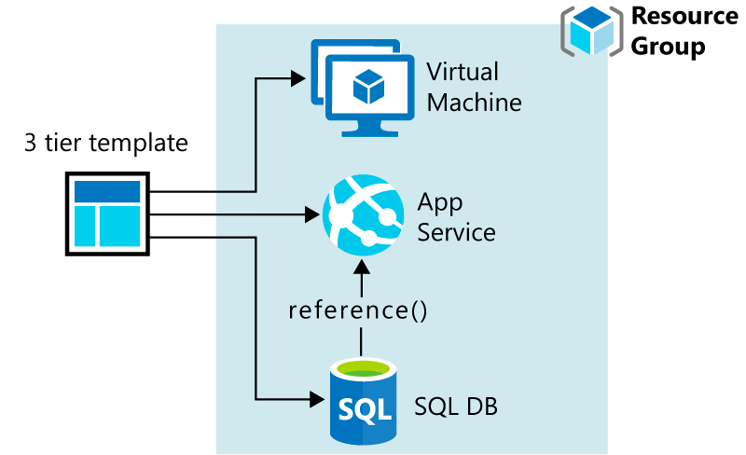
Overview of Resource Manager Templates (1 of 3)
What are Resource Manager templates?
Template design

Slide 4
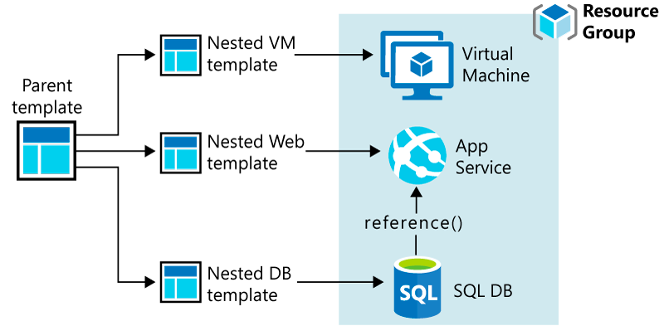
Overview of Resource Manager Templates (2 of 3)

Slide 5
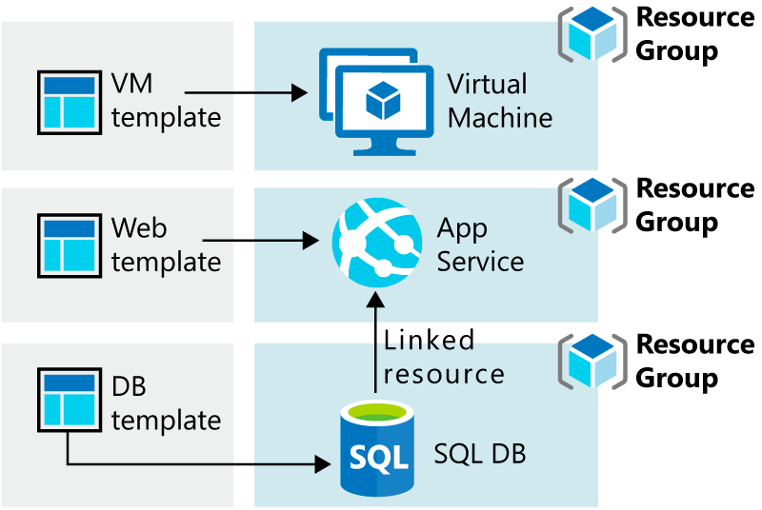
Overview of Resource Manager Templates (3 of 3)

Slide 6
What’s in a Resource Manager Template? (1 of 6)
{
"$schema": "https://schema.management.azure.com/schemas/2019-04-01/deploymentTemplate.json#",
"contentVersion": "",
"parameters": { },
"variables": { },
"functions": [ ],
"resources": [ ],
"outputs": { }
}

Slide 7
What’s in a Resource Manager Template? (2 of 6)
"parameters": {
"adminUsername": {
"type": "string",
"metadata": {
"description": "Username for the Virtual Machine."
}
},
"adminPassword": {
"type": "securestring",
"metadata": {
"description": "Password for the Virtual Machine."
}
}
}

Slide 8
What’s in a Resource Manager Template? (3 of 6)
"variables": {
"nicName": "myVMNic",
"addressPrefix": "10.0.0.0/16",
"subnetName": "Subnet",
"subnetPrefix": "10.0.0.0/24",
"publicIPAddressName": "myPublicIP",
"virtualNetworkName": "MyVNET"
}

Slide 9
What’s in a Resource Manager Template? (4 of 6)
"functions": [
{
"namespace": "contoso",
"members": {
"uniqueName": {
"parameters": [
{
"name": "namePrefix",
"type": "string"
}
],
"output": {
"type": "string",
"value": "[concat(toLower(parameters('namePrefix')), uniqueString(resourceGroup().id))]"
}
}
}}],

Slide 10
What’s in a Resource Manager Template? (5 of 6)
"resources": [
{
"type": "Microsoft.Network/publicIPAddresses",
"name": "[variables('publicIPAddressName')]",
"location": "[parameters('location')]",
"apiVersion": "2018-08-01",
"properties": {
"publicIPAllocationMethod": "Dynamic",
"dnsSettings": {
"domainNameLabel": "[parameters('dnsLabelPrefix')]"
}
}
}
],

Slide 11
What’s in a Resource Manager Template? (6 of 6)
"outputs": {
"hostname": {
"type": "string",
"value": "[reference(variables('publicIPAddressName')).dnsSettings.fqdn]"
}
}

Slide 12
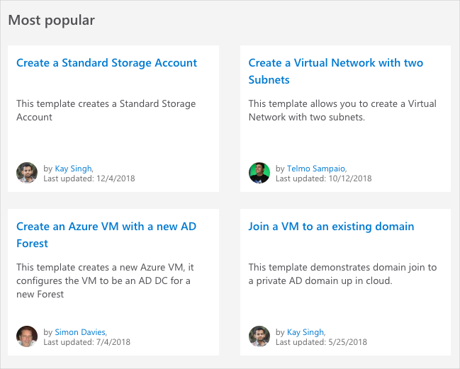
Azure Quickstart Templates (1 of 5)
Browse to Quickstart template gallery

Slide 13
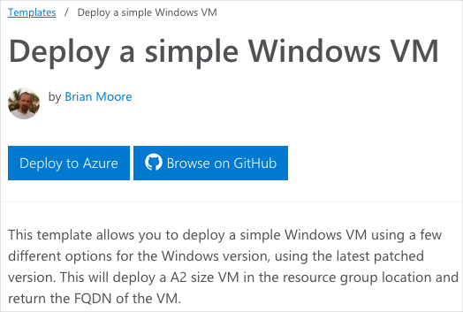
Azure Quickstart Templates (2 of 5)
Select a template

Slide 14
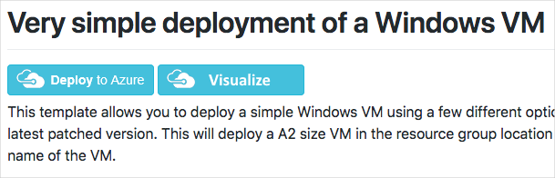
Azure Quickstart Templates (3 of 5)
View the template’s source code on GitHub

Slide 15
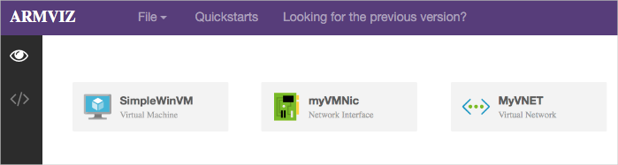
Azure Quickstart templates (4 of 5)
Visualize the template

Slide 16
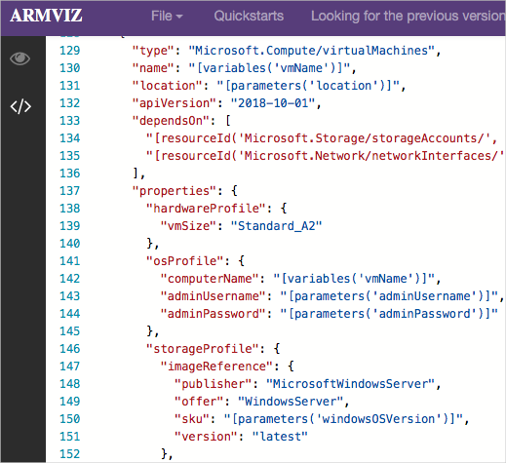
Azure Quickstart templates (5 of 5)
Review JSON that defines the Azure resource

Slide 17
Save a Template for a VM

Slide 18
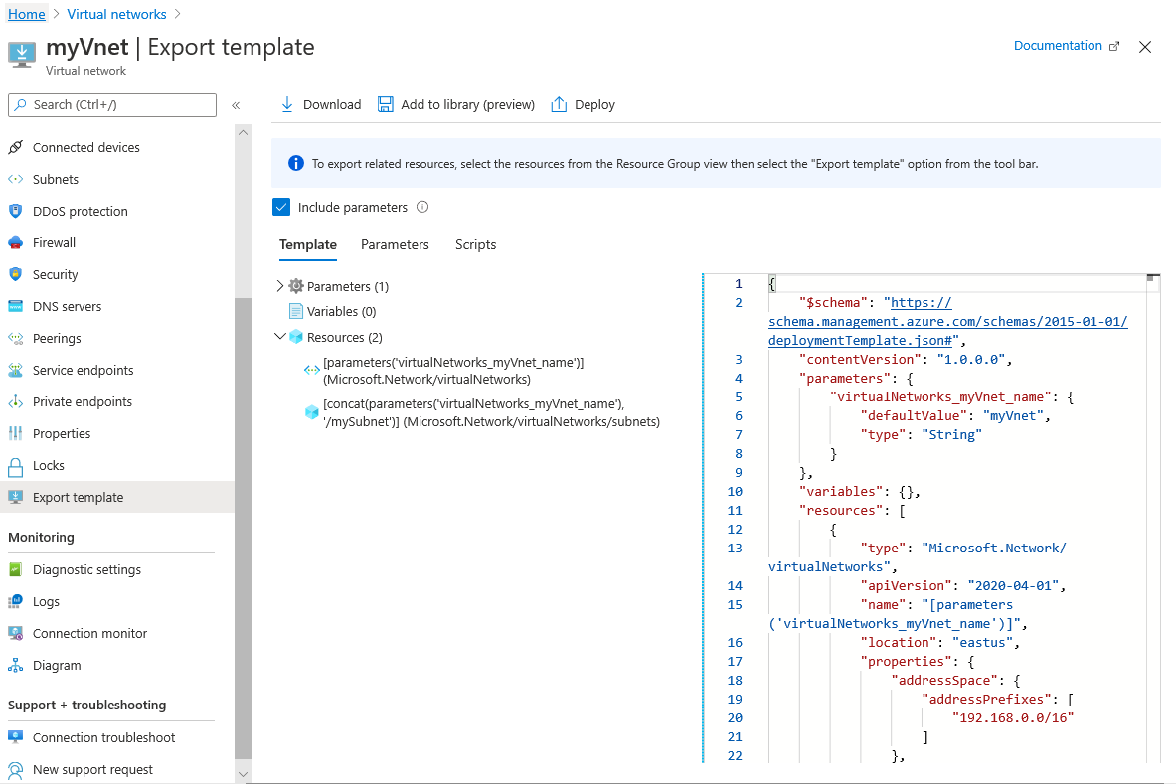
Download the Template for a VM
Export and download the template using the Azure portal

Slide 19
Download the Template using PowerShell
An example of downloading an ARM template using PowerShell:
Export-AzResourceGroup ` -ResourceGroupName "myResourceGroup" ` -Path "C:\users\public\downloads"

Slide 20
Create a Virtual Hard Disk Template

Slide 21
Disk Images for Azure VMs
What is an Azure virtual hard disk?
What is a virtual machine image?
What is a generalized image?
What is a specialized virtual image?

Slide 22
Deploy an Azure VM from a VHD
Use a deployment template:
Include the vhdUrl parameter (URL of the virtual hard disk)
Run a PowerShell script:
# specify storage account of an existing generalized VHD
$storageaccount = (…)
# set generalized VHD URL
$vhdUrl = "https://$storageaccount.blob.core.windows.net/vhds/(…).vhd"
# deploy a VM using the existing VHD
New-AzResourceGroupDeployment -vhdUrl $vhdUrl (…)

Slide 23
Virtual hard Disk Deployment Template
"storageProfile": {
"osDisk": {
"name": "[concat(parameters('vmName'),'-osDisk')]",
"osType": "[parameters('osType')]",
"caching": "ReadWrite",
"image": {
"uri": "[parameters('vhdUrl')]"
},
"vhd": {
"uri": "[variables('osDiskVhdName')]"
},
"createOption": "FromImage"
}
},

Slide 24
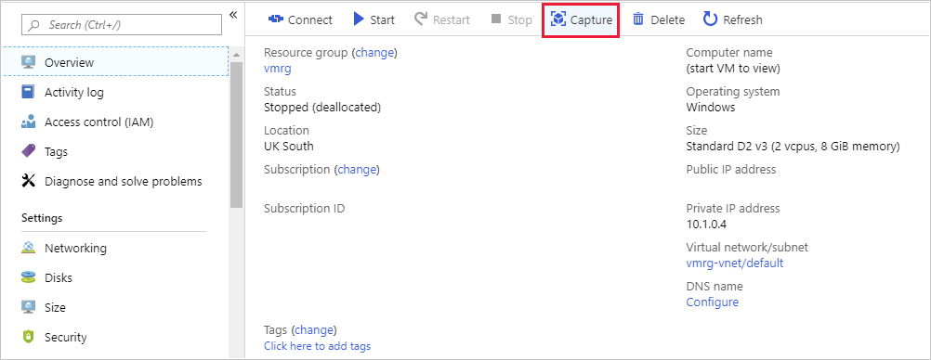
Create a VM from a VHD (1 of 3)
To create an image in the Azure portal:
Generalize the OS of an Azure VM and stop/deallocate it
Go to the blade of the virtual machine and select Capture

Slide 25
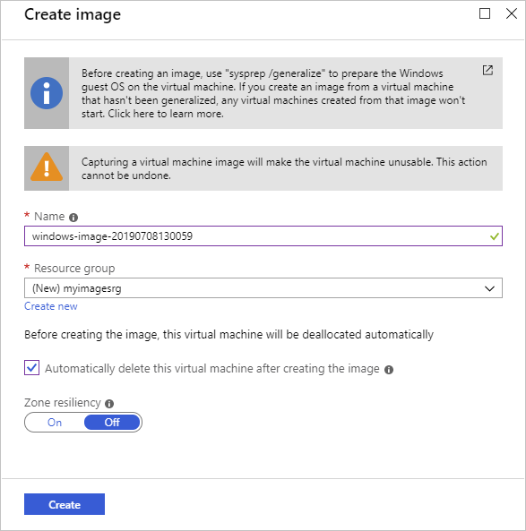
Create a VM from a VHD (2 of 3)
Provide Create image settings
Alternatively, you can use
Azure PowerShell
Azure CLI

Slide 26
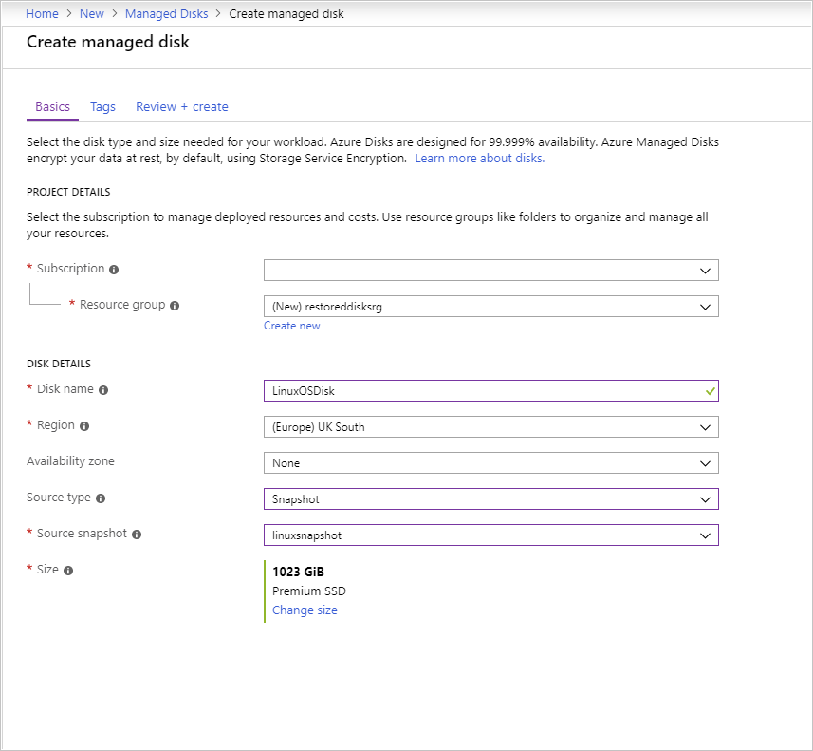
Create a VM from a VHD (3 of 3)
You can also create an Azure VM from a snapshot of its VHD files:
Create a snapshot of each VHD
For each snapshot, create a managed disk
Create an Azure VM using the managed disks

Slide 27
Deploy from a Template

Slide 28
Deploy an ARM template using CLI
Sample deployment of an Azure storage account
"resources": [
{
"type": "Microsoft.Storage/storageAccounts",
"apiVersion": "2019-04-01",
"name": "[variables('storageAccountName')]",
"location": "[parameters('location')]",
"sku": {
"name": "[parameters('storageSKU')]"
},
"kind": "StorageV2",
"properties": {
"supportsHttpsTrafficOnly": true
}
},

Slide 29
Create and Execute an Automation Runbook

Slide 30
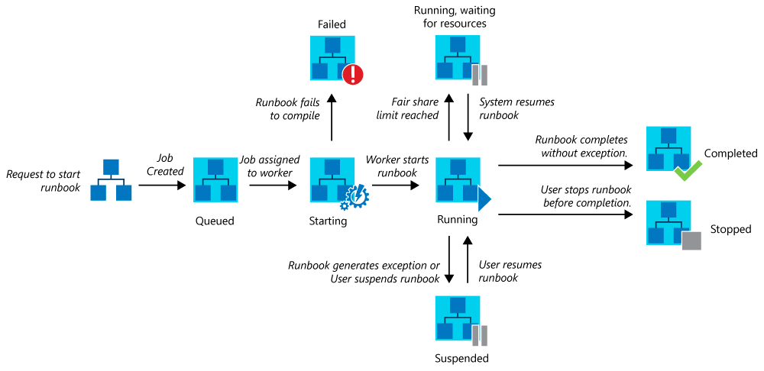

Runbooks in Azure Automation (1 of 2)
The lifecycle of a runbook job for PowerShell runbooks, PowerShell Workflow runbooks, and graphical runbooks

Slide 31
Runbooks in Azure Automation (2 of 2)
Azure Automation Runbooks can run in:
An Azure sandbox: a shared environment, against Azure resources
A Hybrid Runbook Worker: in any environment, directly on the computer that hosts the worker role and against local resources in the environment

Slide 32
Import a PowerShell Runbook from the Runbook Gallery
In the Azure portal:
Select Runbooks gallery under Process Automation
Select Source: PowerShell Gallery
Locate and select the gallery item you want to import
You also have the option of:
Adding a PowerShell Runbook to the gallery
Importing a module from the module gallery

Slide 33
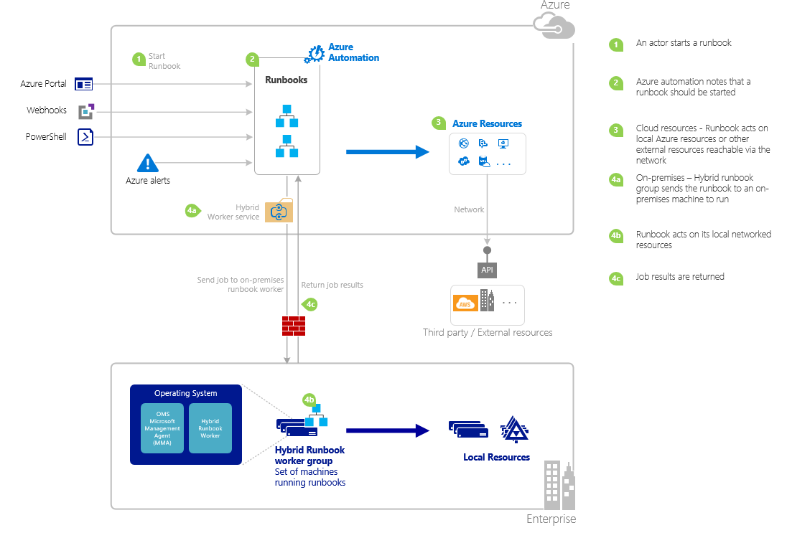
Start a Runbook in Azure Automation (1 of 2)
The life cycle of a Runbook

Slide 34
Start a Runbook in Azure Automation (2 of 2)
You can start a runbook by using:
the Azure portal
PowerShell
Start-AzAutomationRunbook -AutomationAccountName "MyAutomationAccount" ` -Name "Test-Runbook" ` -ResourceGroupName "ResourceGroup01"

Slide 35
Demonstration: Create and Run a Workflow Runbook
Notes:
s
Main Point: It’s better to show it than to say it; but its best to have both!
Students are strongly encouraged to follow along.
The instructor is there to help ensure everyone is following and at minimum observing the steps.
Instructor-led demos should be the standard approach for the provisioning of common services and enables core features (e.g. deploy SQL Azure, deploy VM, setup a webapp, enabling security features, etc.).
Instructors have all demos already running prior to the delivery to minimize waiting time and reducing risk during actual deployment

Slide 36

Module Review Questions

